Slide 1
Attrition Analysis Presentation
What Is Attrition?
Attrition or churn is gradual workforce reduction through employee retirements, resignations, deaths or elimination of positions without immediately filling vacancies.
Unlike turnover, attrition generally involves voluntary departures rather than dismissals or layoffs. It's viewed as a normal and anticipated process in organizations as employees transition into new phases of their lives or careers.

Slide 2
Attrition Rate:
Attrition rate is a metric used to calculate the rate at which employees or customers have voluntarily left a company. The rate of attrition is calculated in proportion to the total employee count in the organisation. Human resources uses this rate to calculate the number of vacant positions so that they can make plans to hire accordingly. A similar rate can also be used to calculate the number of customers who have shifted loyalties from one brand to another. Marketing teams use this data to plan new strategies for retaining customers.
aAttrition rate = (No. of separations / Avg. No. of employees) x 100.rations / Avg. No. of employees) x 100

Slide 3
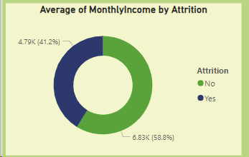
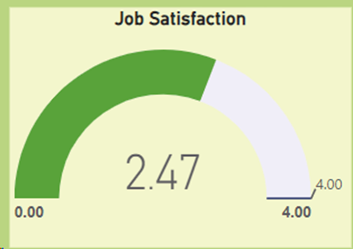
Inadequate compensation and benefits: While salary isn't the source of all employment satisfaction, low pay and non-competitive benefits, coupled with lack of pay parity and transparency can lead employees to seek greener pastures. Employee attrition can impact organizational stability and increase recruiting costs to find and train new talent.
Unrealistic work load expectation: Excessive workloads not only challenge an employee's capacity to maintain a healthy work-life balance but also significantly erode their job satisfaction, leading to increased attrition as individuals seek more sustainable employment environments.

Slide 4
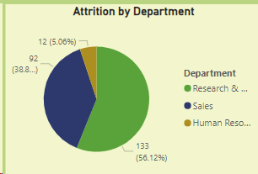
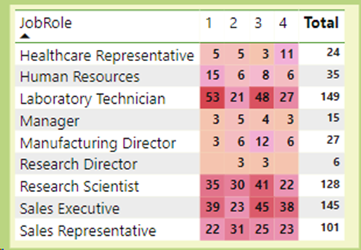
Work/life imbalance: Today’s employees value personal time and work/life balance more than previous generations. Employers who do not acknowledge this shift may find themselves with higher attrition rates. Overworked and underappreciated employees can seek out companies who place higher value on work/life balance, contributing to a workforce's dwindling satisfaction and engagement.
Ineffective management practices: Managers play a pivotal role in employee satisfaction and turnover. Difficult leadership styles and a lack of effective communication erode trust and confidence within teams. A scarcity of recognition for employees' contributions and achievements can also diminish their motivation and commitment to the organization

Slide 5
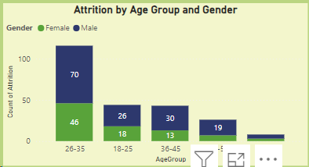
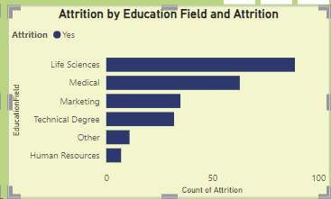
Lack of career advancement opportunities: The absence of clear career advancement opportunities in an organization hinders the personal and professional growth of its workforce and significantly increases the likelihood of employee attrition, as individuals seek environments where they can continually evolve and contribute at a higher level.
Ineffective management practices: Managers play a pivotal role in employee satisfaction and turnover. Difficult leadership styles and a lack of effective communication erode trust and confidence within teams. A scarcity of recognition for employees' contributions and achievements can also diminish their motivation and commitment to the organization

